Slide 1

Intelligent Power Management
30+ Years Power Conversion Expert

Slide 2


Contents
About Leistung Energie
Capability
Products
References

Slide 3


ABOUT LEISTUNG ENERGIE
30+ Years Power Conversion Expert

Slide 4

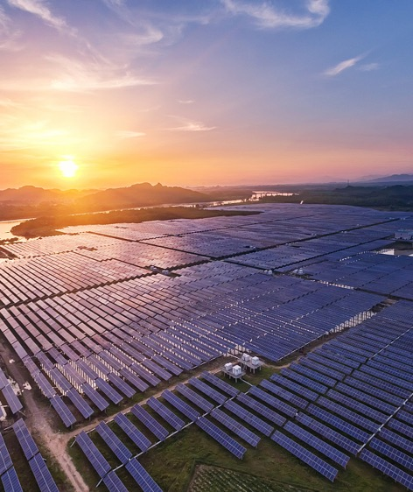

ABOUT LEISTUNG ENERGIE
Business Layout
Critical Power
Renewable Energy
Cloud Infrastructure
Power Protection
System Integration
Power Management
PV Inverter
ESS/Micro-grid
EV Charging
Cloud Service
Cloud Security
Cloud Power

Slide 5
ABOUT LEISTUNG ENERGIE
Snapshots
Experience since
1988
320,000 m²
Manufacture
area
Users in 100+ countries and regions
1000+
Engineers
Public
company
Revenue exceeding 4.1 Billion RMB annually

Slide 6
ABOUT LEISTUNG ENERGIE
Milestones
Utilize 30+ years experience to fuel development of global customers.
1997
2016
2018
2020
Started overseas business
Top 5 in annual energy storage inverter shipments worldwide
(IHS Markit)
No.1 Chinese UPS brand for 20 years
Launched the world’s first 125kW UPS power module
1988
2007
2015
2019
Founded in Zhangzhou, China
PV inverters and UPS for wind power is launched, stepping into renewables
Independently developed China’s first set of nuclear island-grade UPS equipment and filled a gap in the nation’s technology
Ranked Global Top 500 New Energy Enterprises for 5 consecutive years
Industrial UPS market share
No.3 worldwide, No.1 in Asia
(OMDIA)

Slide 7



ABOUT LEISTUNG ENERGIE
Achievement
Critical Power
Renewable Energy
Cloud Infrastructure
No.1
Domestic UPS brand for 23 years
No.1
Market share of behind the meter ESS in China
No.1
Market share of modular data center in China

Slide 8
CAPABILITY
30+ Years Power Conversion Expert

Slide 9

CAPABILITY
Overview
D&B rating 5A-
Financial strength
Sustainable growth
Professional team
Training & guidance
24/7 online support
On-site support
Stability
Service
LEISTUNG ENERGIE
CAPABILITY
Experienced R&D engineers
Leading technology
Intellectual property
Quality Certificates
Supplier Quality Control
Whole process QC
R&D
Quality
Scientific planning
Optimized production lines
Maximized Efficiency
Quick response to market
First-class facility
Sufficient production capacity
Flexible and agile scheduling
Fast delivery
Supply Chain
Manufacture

Slide 10

CAPABILITY
Stability
Financial Capacity
Revenue Growth
D&B Rating 5A⁻ = Superior financial capacity & credit condition
EMMA Score 3 = Moderate Low Risk
Net profit growth 174% in 2019
Net profit growth 88% in 2020

Slide 11

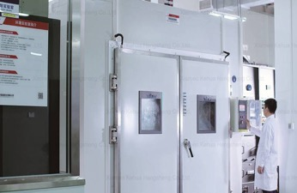

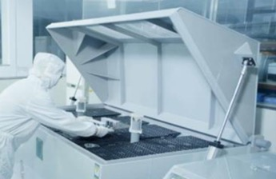
CAPABILITY
R&D Strength
● 4 State Council Experts.
● 1000+ Engineers.
● Participate in 90+ national and industrial standards development.
● 800+ Patents & Copyrights.
● 40+ National/Provincial Torch Plan Project
● National key high-tech enterprises
● Postdoctoral Research Station
● United Lab with famous universities and laboratories around the world

Slide 12
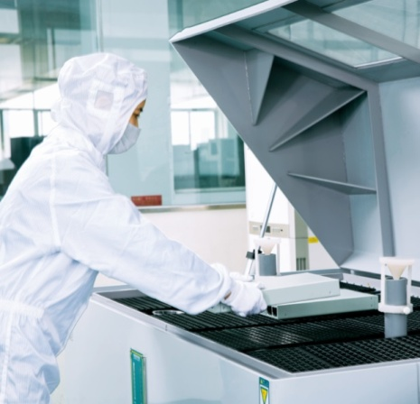

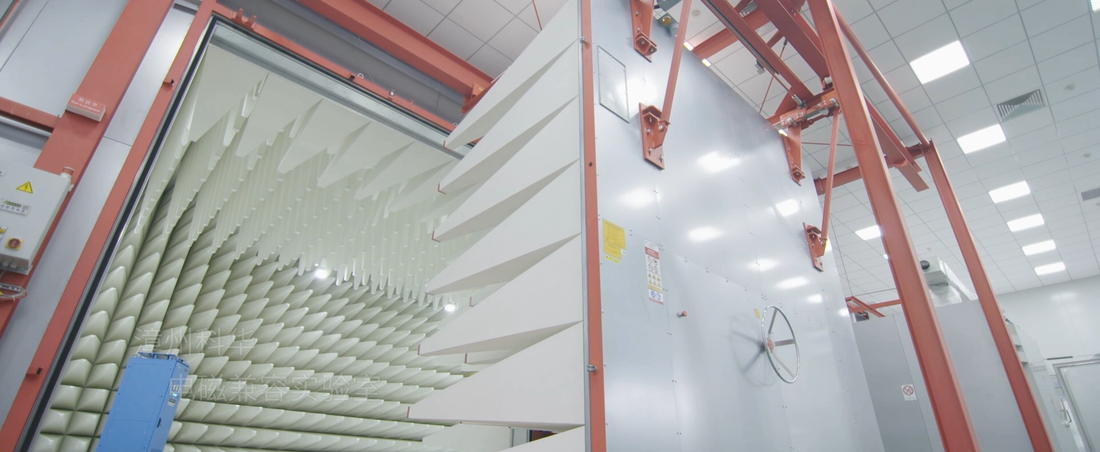


CAPABILITY
R&D Strength
EMC Test
High & Low Temperature Test
Salt-spray Test
Anti-dust Test
Vibration Test
EMC Lab
Battery Cycling Lifetime
MW Test Lab

Slide 13
CAPABILITY
Supply Chain
Strict quality control leads to reliable products, which meet the quality requirements of high-end market.
Scientific planning and efficient cooperation internal and external to shorten lead time and achieve prompt delivery.
Professional team to support integrated procurement, better service for projects
Agility
Quality
Cost
Integration
Efficiency
Process orientation and management innovation lead to continuous cost reduction and improvement of product cost performance
Flexibility
The combination of job optimization, automation and information management to continuously optimize processes, improve the system, and enhance work efficiency.
Optimized production line layout and operation mode to strengthen delivery capacity

Slide 14
CAPABILITY
Manufacture
4
manufacture bases
320,000 m²
manufacture area
2 million units
annual production
Xiamen (HQ)
Zhangzhou
Jiaomei
40 GW
annual solar production capacity
Foshan

Slide 15

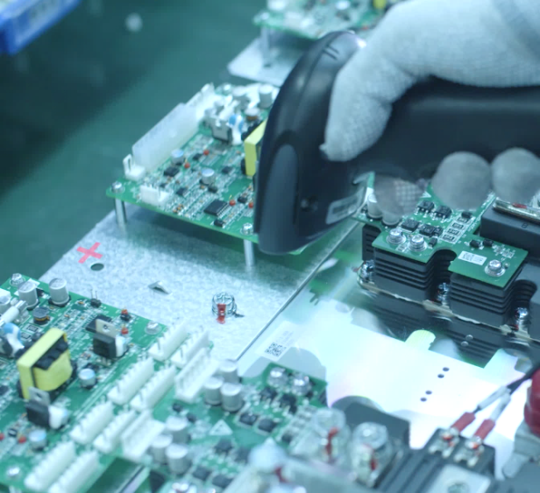
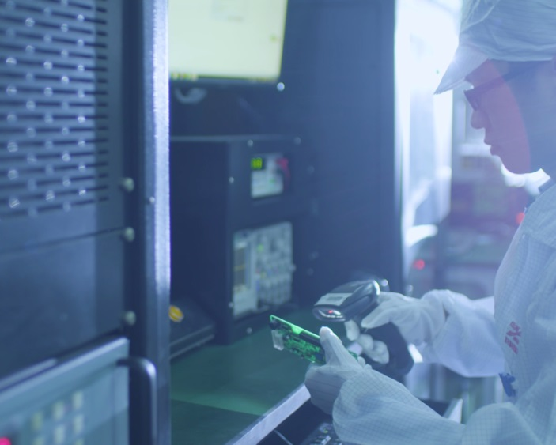
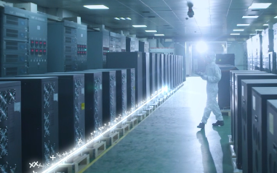

CAPABILITY
Quality Control
Order
Procurement
Receiving
Production
Testing
Delivery
Supplier Quality Management
Incoming Quality Check
Total Quality Management
Process Quality Control
InPut Process Quality Control
ORT Outgoing Reliability Testing
Outgoing Quality Control
Final Quality Control
Quality Tracking & Analysis

Slide 16


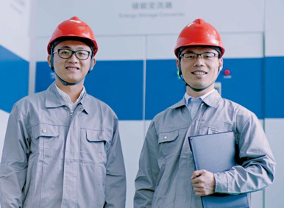
CAPABILITY
Service
3A Service System - Assured Apropos Active
Training & Guidance
24/7 Online Support
Onsite Support
Empower technical engineers of partners with service abilities. Materials and seminars to assist installation, commissioning, product update etc.
Based on the concept of full lifecycle service, we put responsiveness and responsibility before all else.
Service network covers China, India, USA, Middle East, France, Indonesia, South Korea and Vietnam. Quick response in local area.

Slide 17
PRODUCTS
30+ Years Power Conversion Expert

Slide 18

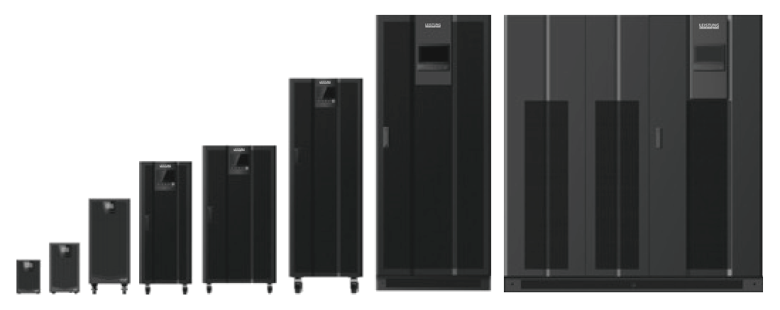
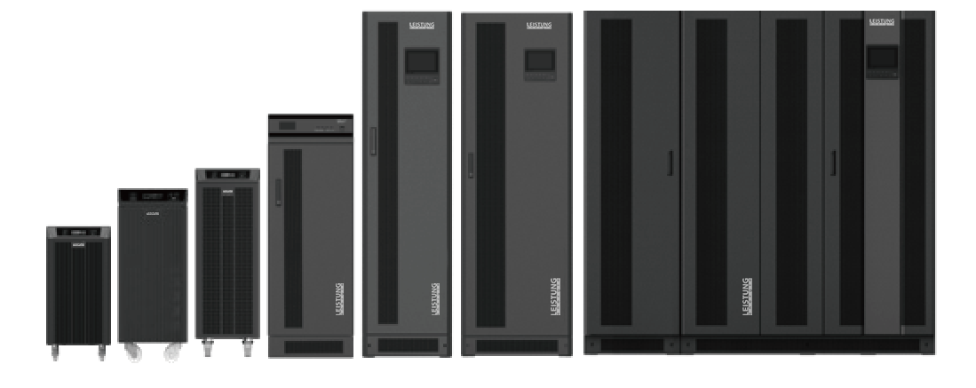
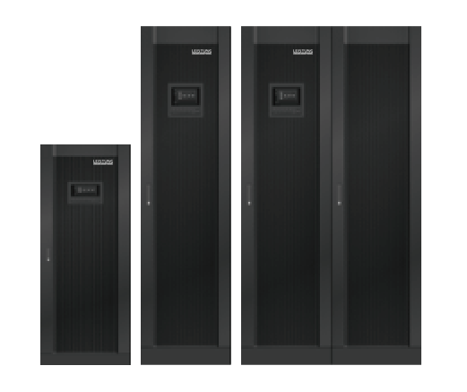
PRODUCTS
Critical Power
Transformer-less UPS
KR Series, Single Unit 1-1200kVA
Transformer-based UPS
FR-UK Series, Single Unit 1-600kVA
Modular UPS
MR Series, Single Unit 50-1200kVA

Slide 19

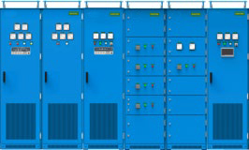
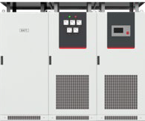


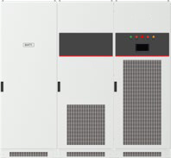

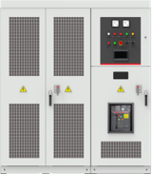

PRODUCTS
UPS - Special Application
Nuclear island class UPS
FR-UK-HD Series
Power industry UPS
FR-UK31DL Series
Rail transit power supply
FR-UK-GEL Series
Industrial anti-vibration power supply DC-BANK
Emergency Power Supply
Double-fed subway brake energy feedback device
HVDC power supply

Slide 20

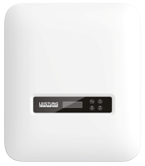
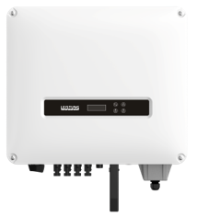
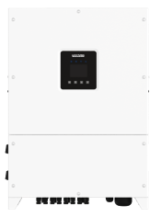
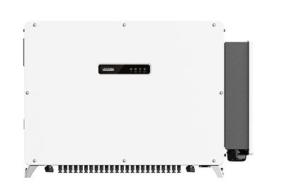

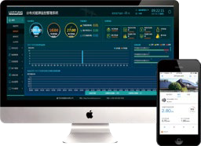
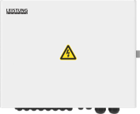
PRODUCTS
String Inverter
SPI 3-6kW
SPI 5-20kW
SPI 30-60kW
SPI 125/250kW
WiseEnergy Monitoring System
AC/DC Combiner Box

Slide 21

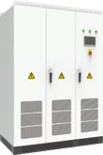
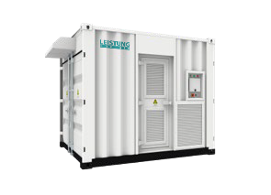
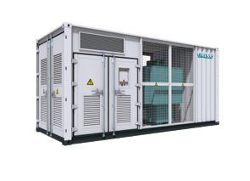
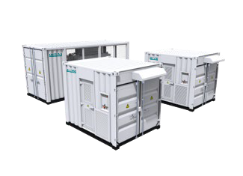
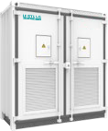
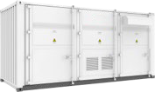
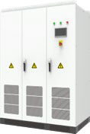
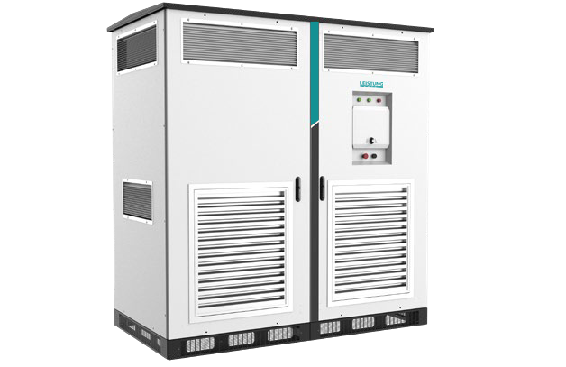
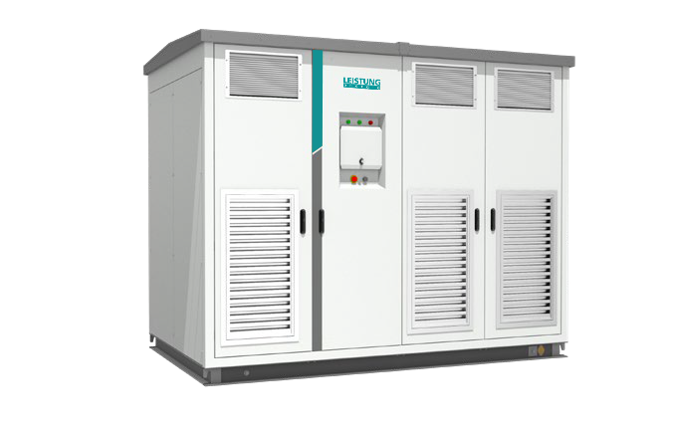
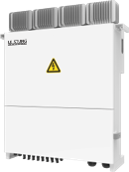
PRODUCTS
Central Inverter
Single Unit
500-1000kW
Container
0.8-6.8MW
Turnkey Solution
1-6.8MW (10kV/35kV)
Single Unit
1000-1700kW
Outdoor Container
3125/4167kW
Intelligent
MPPT Controller

Slide 22

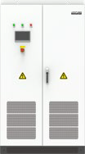
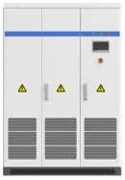
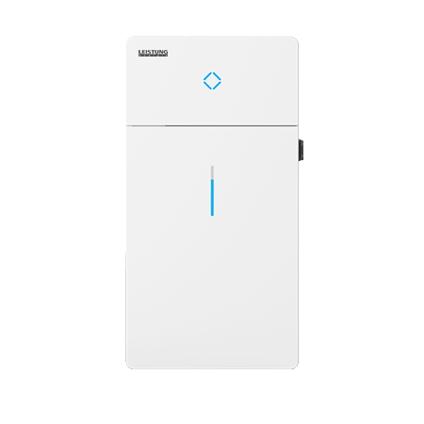
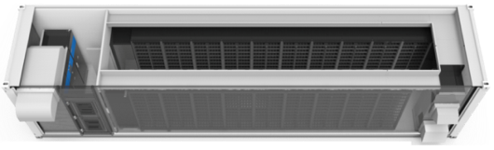
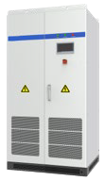
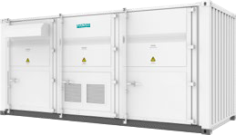
PRODUCTS
Energy Storage
BCS 100-500kW
BCS 250-630kW
BCS-B-H 1250-1500kW
iStoragE
Containerized Energy Storage System
MW-level ESS
DC-DC

Slide 23
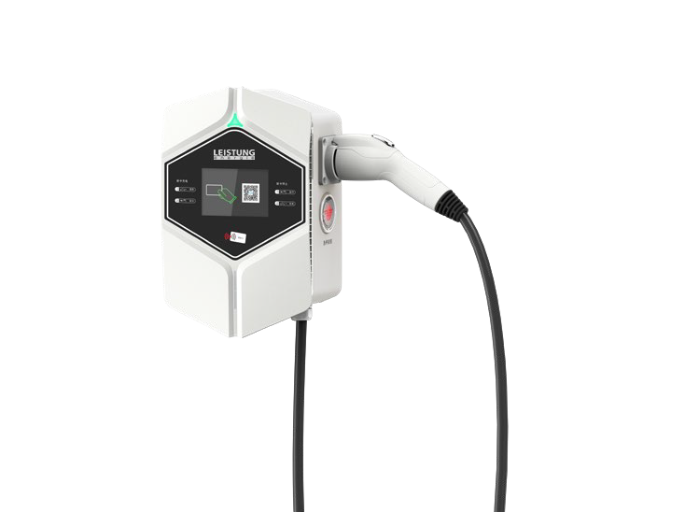
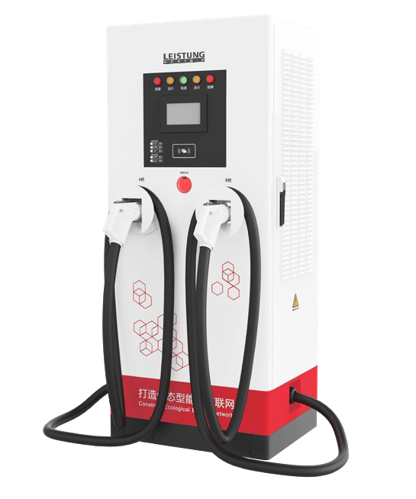
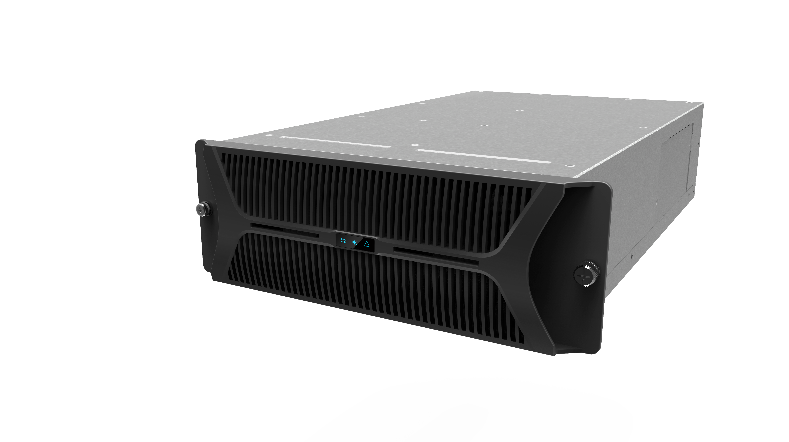
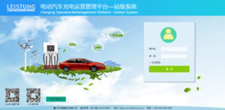

PRODUCTS
EV Charging
Charger Module
Charging Operation Management Platform
APP
AC Charger
DC Charger
Integrated Charger
Single gun/Double gun
Split Charger
Single gun/Double gun
Charging Module

Slide 24
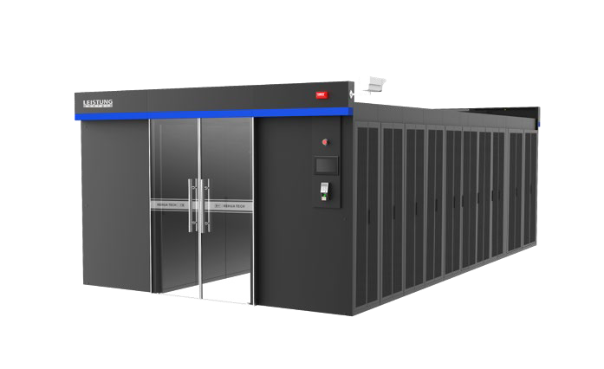
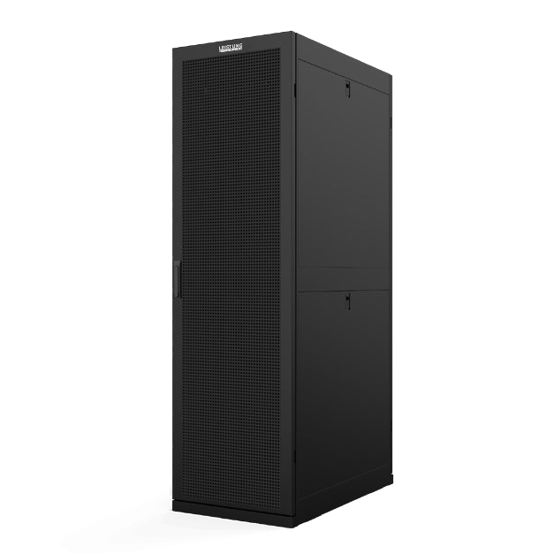
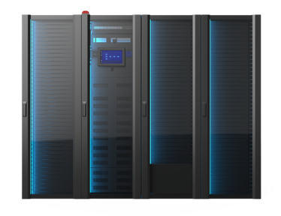
PRODUCTS
Cloud Infrastructure
WiseCabinet
Mini Data Center
WiseRow
Small Data Center
WiseAisle
Modular Data Center
PUE<1.4

Slide 25
REFERENCES
30+ Years Power Conversion Expert

Slide 26

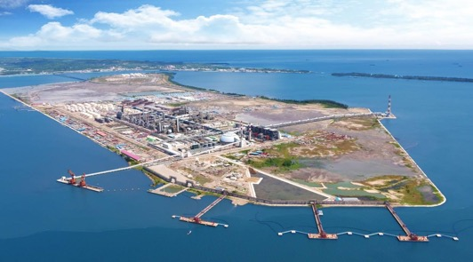
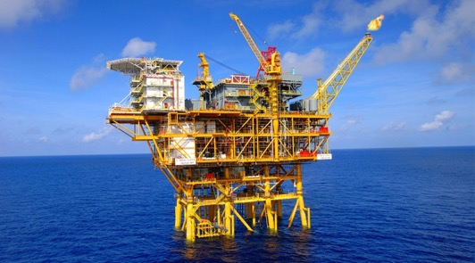
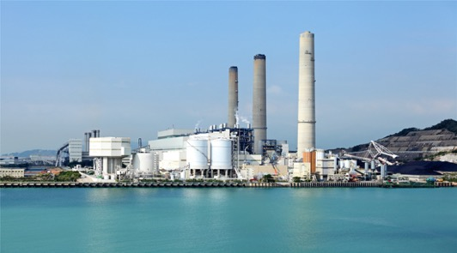
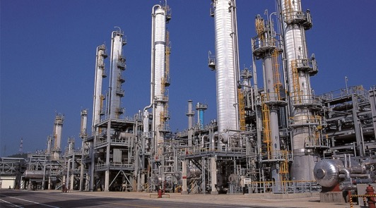
High power UPS system for
the drilling platform of China National Offshore Oil Corporation
ENERGY & CHEMICAL INDUSTRY
Contributions to the accuracy and safety of energy & chemical production and distribution. Leistung Energie solutions have been recognized by leading companies in the industry.
Power solutions for
Brunei Hengyi PMB project
world’s largest petrochemical industry base.
Pemex Mexico, the largest oil company in Mexico, adopted Leistung Energie UPS for production control system
Leistung Energie UPS applied in
Gazprom Neft Russia, one of the Top3 oil refining companies in the nation.

Slide 27
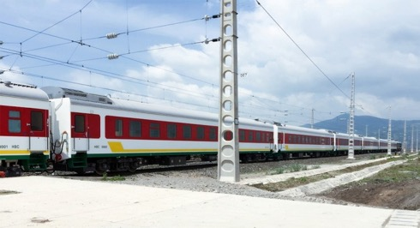



TRANSPORTATION INDUSTRY
40+ Cities.
100+ Routes.
Over 35% market share of critical power for rail transportation.
Increasing participation overseas.
Power protection for the control system of Ethiopia railway.
Power solution for
the port security system of
Hong Kong-Zhuhai-Macao Bridge.
Leistung Energie high power UPS adopted by Faleolo International Airport.
Power solution for
Beijing Capital Airport Terminal 3,
the largest single terminal in the world.

Slide 28





MEDICAL INDUSTRY
Proven reliability in tandem with precision medical instruments. Leistung Energie UPS is widely adopted by clinics and hospitals in China, Russia, Sweden, Indonesia, Burma etc.
Moscow Institute of Health Medical Center adopts Leistung Energie UPS for medical equipment.
Leistung Energie high power UPS in
Sweden Hospital.
Leistung Energie UPS ensures power supply for
clinics in Russia.

Slide 29



PUBLIC SERVICE
Participation in international events and summits to ensure reliable power supply.
High power UPS for
2010 Shanghai World Expo
Leistung Energie UPS systems for
2010 Angola Africa Cup
Leistung Energie power
solution for 2008 Beijing Olympic Games

Slide 30




Leistung Energie UPS is applied in the
network security system of
Sberbank Russia, a state-owned banking and financial service company headquartered in Moscow.
10-80kVA UPS system for Guangfa Securities to expand server capacity and computer terminal.
FINANCE INDUSTRY
Leistung Energie has been serving finance and banking users for over 30 years, solutions ranging from single equipment to vast systems designed for large data centers.
Leistung Energie UPS system has been used in the People’s Bank of China since 1990s.
Power supply system for telecom operators in Bangladesh.

Slide 31



MANUFACTURING INDUSTRY
Leistung Energie UPS is widely applied in the manufacturing of automotive, textile, food, pharmaceuticals, industry materials etc.
Power solutions for Royole, the world first production line of the 6th generation screens with flexible display
Leistung Energie UPS applied in the factory of Levi’s Jeans
in Sri Lanka
UPS system for the assembly plant of Ford Motor Company in Johannesburg, South Africa.

Slide 32



200MW 1500V PV project in India.
Accumulative installation 1.8GW+
100MW PV power plant in Orenburg, Russia.
Leistung Energie SPI800K central inverters was adopted.
Top Runner project in Delingha,
Qinghai-Tibet Plateau. Height 3,050m. Temperature -27.9ºC.
PV POWER STATION
Leistung Energie central inverters are widely applied in the PV power stations in various countries due to the features of cost-effectiveness, reliability and high electric power quality.

Slide 33




DISTRIBUTED PV POWER STATION
Leistung Energie string inverters are widely applied in industrial & commercial sector to fuel sustainable development of small and medium-sized enterprises.
2MW PV Power Plant Project in South Korea
Rooftop PV Power Plant in
San Francisco, USA

Slide 34



RESIDENTIAL PV& ENERGY STORAGE
The excellent performance of Leistung Energie products has been recognized by customers around the world. We are committed to endow every family with the ability of intelligent power management and build a clean future for us all.
Residential 3.6kW+2kWh energy storage project in Italy.
Residential PV inverter applied in Australia.
Residential 3.6kW+2kWh energy storage project in Argentina.

Slide 35




720MWh Energy Storage Power Station Project in Gansu, China
ENERGY STORAGE
One of the development focus of Leistung Energie. Technological advantage leads to market expansion and customer loyalty.
Peak load shifting ESS project in North America
Micro-grid Project
in Madagascar

Slide 36



PV+ SOLUTIONS
“PV+” model would be a reform to the energy market. With leading technologies and excellent products, Leistung Energie is able to provide comprehensive energy solutions and create one-stop service experience for customers.
PV+ESS 1.2MW power supply system for an oil field in Uzbekistan.
PV+ESS+EV Charging in Shenzhen, China. Breaks the bottleneck of green bus charging.
PV + Transportation
Guangzhou Yuzhu Roof Distributed PV Power Generation Project.

Slide 37





9.6MW charging station
in Shanghai.
Xiamen Municipal Engineering Project,
total charging power exceeding 3MW.
Super Charging station in Wuhan
EV CHARGING
Sufficient experience on government and commercial projects in China. Proven performance and excellent service drive expansion in overseas market.
Listed supplier for China City Alliance Project
in Shanghai, Shenzhen, Xiamen with Top developers
Bus charging station
in Longyan City

Slide 38





Guangzhou Keyun
Cloud Computing Center
Shanghai
Cloud Computing Center
SELF-BUILT DATA CENTERS
7 self-built IDC under independent operation,
cover more than 23,000m² in 10 major cities of China,
with 28,000+ racks of construction.
Beijing Yizhuang
Cloud Computing Center
Guangdong Dongyong Cloud Computing Center
Guangdong Mingmei
Cloud Computing Center

Slide 39



43 sets micro-modules for China Telecom (Jishan) Data Center Phase I.
MICRO-MODULES
Leistung Energie micro-modules are customized according to needs of projects, with proven features of energy-saving, reliability and convenience of operation & maintenance.
45 sets micro-modules for BaoCloud IDC Project Phase IV.
232 sets micro-modules for China Mobile (Nanjing) Data Center Phase I.

Slide 40































Leistung Energie PARTNERS
Top class clients and partners cover almost all industries

Slide 41


