Slide 1
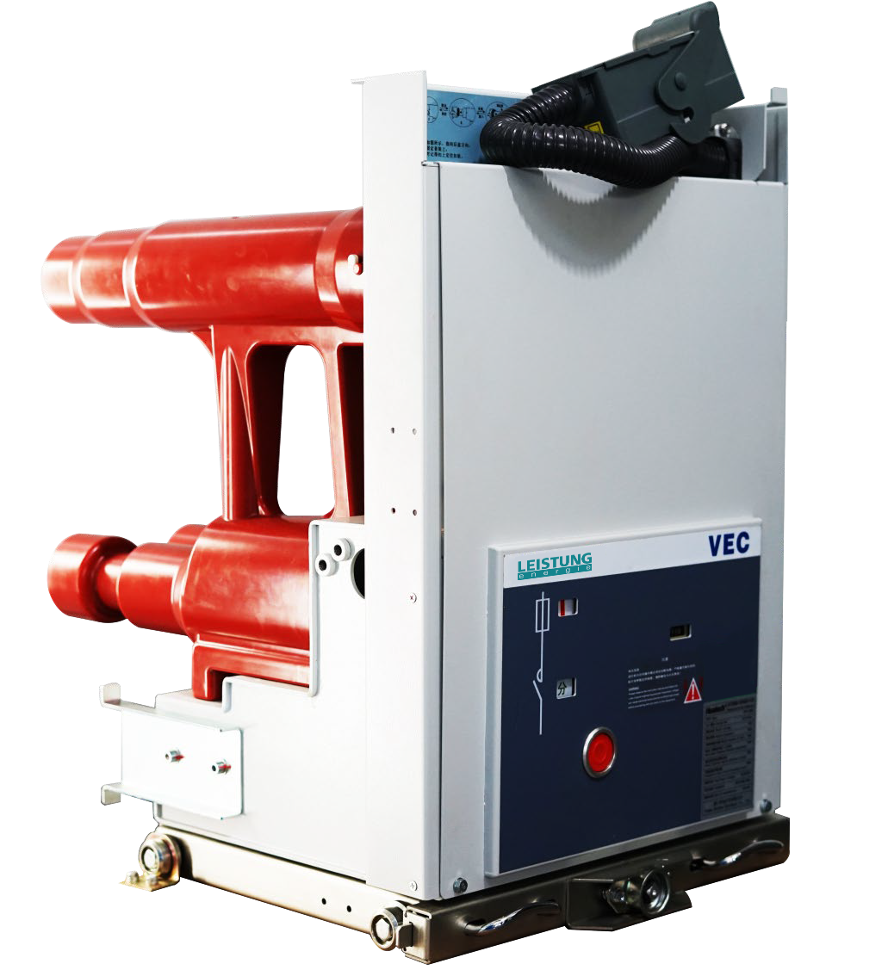
VEC
Vacuum Contactor
^{7.2kV/12kV,…400A,…4kA}

Slide 2
Contents
Outline
Technical Features
Structural Features
Technical Parameters
Product Models
Ordering Instructions
Electrical Control Wiring
Outline Dimension Drawing
Fuse Selection Guide
Notes
4
5
6
7
9
10
11
15
18
20
www.leistung-energie.com
VEC Catalog

Slide 3
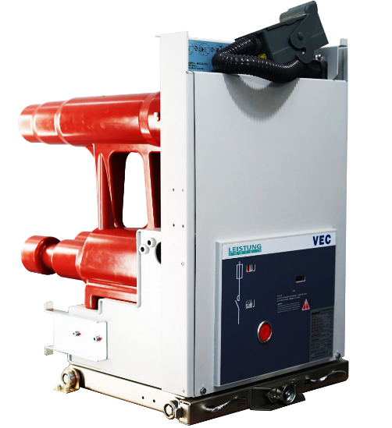
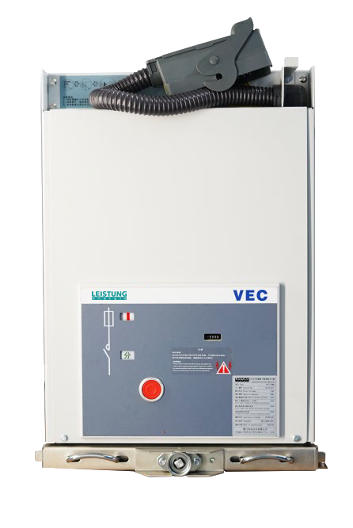
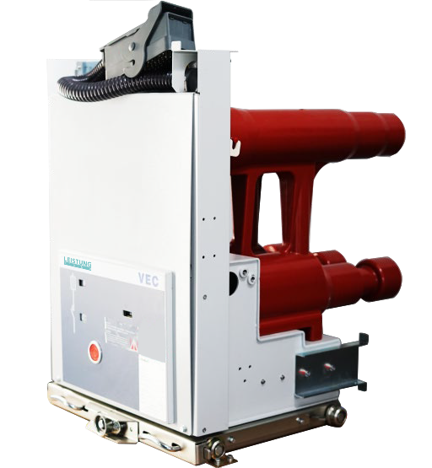
Outline
▍
VEC vacuum contactor & fuse combination unit is an indoor switchgear developed by Leistung Energie, with rated voltage of 3.6 ~ 12kV working in three-phase AC distribution system.
VEC vacuum contactor & fuse combination unit has passed the whole set of type testing.
There are full specification series of VEC vacuum contactor & fuse combination products, reaching the internal advanced level.
Design and manufacture of VEC vacuum contactor & fuse combination unit is in full conformity with the standards of GB, DL, IEC, DIN VDE and other advanced industrialized countries.
VEC vacuum contactor & fuse combination unit is mainly used to control and protect high voltage motors, transformers and capacitor banks, which require frequent start-up .
VEC vacuum contactor & fuse combination products have reasonable structure, compact size, light weight, long mechanical life, high reliability, low cut-off current value and long electrical life. It is a high-performance, maintenance-free vacuum contactor & fuse combination unit.
▍Application Field
Power station
Power distribution network
Industrial systems (petrochemicals, metallurgy, etc.)
4 | VEC Catalog
www.leistung-energie.com

Slide 4
Technical Features
▍ Application Environmental Conditions
Ambient temperature
Max. +40℃, Min. -15℃, Average daily temperature ≦ +35℃
Environmental humidity
Average daily relative humidity ≦ 95%
Average monthly relative humidity ≦ 90%
Maximum altitude：1000m
Seismic intensity：no more than 8 degrees
VEC vacuum contactor & fuse combination unit is designed according to the normal operating environment conditions and should be installed in a place without fire, explosion hazard, and serious pollution, with no chemical corrosive gas and fierce vibration. Consultation should be held between both users and manufacturers if actual operating conditions are different from normal.
▍Application Area
VEC vacuum contactor & fuse combination unit is widely used in power distribution sites which require frequent operation, such as industry, power plant, oil drilling platform etc., to provide reliable control and protection for electrical equipment. In combination with a fuse capable of breaking a wide range of short-circuit fault current and its current limiting effect, VEC can be used in circuits with short-circuit capacity up to 1000 MVA.
VEC vacuum contactor & fuse combination unit is equipped with high-performance vacuum interrupter, which enables VEC to be used with fuse to control and protect motors, capacitor and transformer banks etc. under extremely harsh conditions.
▍Main Technical Features
Low chopping current of 0.3A results in an extremely low operating voltage
Extremely long mechanical and electrical life, up to 1,000,000 electrical self-holding operation cycles , and 300,000 mechanical self-holding operation cycles
Maintenance-free operation system
Meet the requirements of remote operation
It can cooperate with microcomputer-based integrated protection relay to realize selective actions
Rated breaking current and take-over current up to 4000A
A fuse tripping device is equipped to avoid phase-deficiency operation of the load
www.leistung-energie.com
VEC Catalog | 5

Slide 5
Structural Features
▍Structural Features
Withdrawable type of VEC vacuum contactor & fuse combination unit
Products include vacuum interrupter, operating mechanism, control electromagnet, wide voltage power supply module, main circuit fuse and other auxiliary components. All have reasonable structure and high reliabilities.
Two modes available: electrical self-holding or mechanical self-holding.
Mid-set withdrawable cabinet with 650mm wide switchgear cabinet, compact design meets the space requirements.
Physical dimension is completely consistent with the VEP handcart, and the "five prevention" interlocking position is the same as that of the circuit breaker switchgear, with a purpose of convenient interchange.
Unique seal design
The advanced double automatic pressure gelation process (APG) simplifies the assembly process of poles with an improved reliability.
The new technology of embedded pole avoids the influence from external environment and improves the electric field distribution of the pole.
High quality silicone rubber material can cushion the extrusion force between the interrupter and the pole, and ensure the reliable operation of the product in hostile environment.
Modular operating mechanism
Electromagnetic operating mechanism has two options: electrical holding and mechanical holding.
Simple and reasonable design structure with high mechanical strength ensures the stable and reliable mechanical performance of the products.
Modular design, simple maintenance with universal parts standards.
Fuse installation mode
The fuses are respectively mounted in the semi-enclosed fuse chamber and can be replaced in the testing position.
Simple and fast replacement by uncoupling the front cover positioning fastener.
▍
Note：VEC Structure chart
6 | VEC Catalog
www.leistung-energie.com

Slide 6
Technical Parameters
▍Main Technical Parameters for VEC Vacuum Contactor
Name | Unit | Data
Rated voltage | kV | 3.6/7.2 | 12
Rated frequency | Hz | 50/60
Rated power frequency withstand voltage（1min） | kV | 32 | 42
Rated lightning impulse withstand voltage | kV | 60 | 75
Rated current/Rated breaking current | A | 400
Rated short-time withstand current (4s) | kA | 4
Rated closing current | kA | 4
Limiting breaking current | kA | 4 | 4
Main circuit resistance | uΩ | ≦200
Chopping current | A | 0.3
Use category |  | AC-4
Mechanical life（electrical self-holding） | time | 1,000,000
Mechanical life (mechanical self-holding) | time | 300,000
www.leistung-energie.com
VEC Catalog | 7

Slide 7
Technical Parameters
▍Main Technical Parameters for VEC Vacuum Contactor & Fuse Combination Unit
Items |  | Unit | Data
Rated voltage |  | kV | 3.6/7.2 | 12
Rated insulation level | Rated short-time power frequency withstand voltage（1min） |  | 32 | 42
 | Rated lightning impulse withstand voltage (peak) |  | 60 | 75
 | Rated short-time power frequency withstand voltage （1min） |  | 2
Rated frequency |  | Hz | 50/60
Rated current |  | A | 250 | 160
Rated short-circuit closing current (peak) |  | kA | 130
Rated short-circuit breaking current (expected value) |  |  | 50
Rated take-over current |  | A | 4000 | 4000
Main circuit resistance |  | uΩ | ≤250
▍
Note: The high voltage fuse is replaced by an analog fuse with a negligible resistance when measuring the resistance of main circuit.
8 | VEC Catalog
www.leistung-energie.com

Slide 8
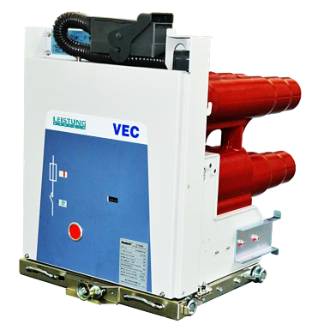
Product Model
Product Model
VEC 07 M
Holding method（M: Mechanical holding, E: Electrical holding）
Rated working voltage (kV)（07: 7.2kV，12: 12kV）
Model of vacuum contactor
▍Product Model Description
Vacuum contactor series products include VEC pole spacing 205mm and VEC pole spacing 310mm versions, the specific models are as follows:
VEC Pole Spacing 205mm | VEC Pole Spacing 310mm
Product Features
• Compact design
• Exactly same interface size as last version product
Application Area
• High voltage motors, transformers and capacitor banks requiring frequent start-up;
• Power plant, power grid, petrochemical, metallurgy and other new station projects;
• High voltage motors, transformers and capacitor banks requiring frequent start-up;
• Spare parts supplement and after-sale maintenance of previous version products;
• Power transformation of power grids and industrial projects;
Advantages of New Product
Totally new embedded pole technology ensures that the main circuit is free from environmental impact and improves the adaptability of products in harsh environment;
Modular mechanism design, simple and reasonable structure, high mechanical strength, stable and reliable operations;
Convenient fuse installation mode. Installation and replacement can be completed in testing position, which is easy and fast, efficient and reliable;
Reliable secondary circuit design for control and protection. It can cooperate with microcomputer-based integrated protection relay to realize safe operation;
www.leistung-energie.com
VEC Catalog | 9

Slide 9
Ordering Instruction
Ordering Instruction
▍Ordering Instruction
Model, name and quantity of vacuum contactor;
Closing and opening operation voltage, and whether mechanical holding is needed;
Type and current of fuse (to be ordered separately);
Model, name, specification and quantity of spare parts;
Please indicate any special circumstances in the order agreements;
For the upgrading and replacement of contactor products for some specific projects, the actual project site situation and the diversity of secondary electrical connections need to be considered;
Please contact the manufacturer for more technical support before selecting the model;
▍Delivery Document & Attachment
• Delivery document include：
a. Product certificate and factory inspection report
b. Product manual
c. Packing List
• Attachment
a. Push-in handle of handcart for vacuum contactor
b. Secondary socket and pin of vacuum contactor
10 | VEC Catalog
www.leistung-energie.com

Slide 10
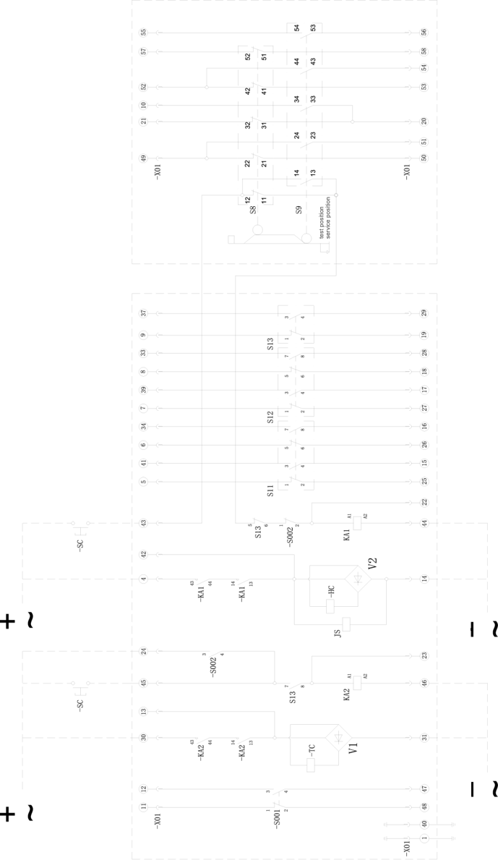
Electrical Control Wiring
Electrical wiring diagram for with drawable type VEC vacuum contactor & fuse combination unit（mechanical holding）
▍
Note: this figure corresponds to the state that the contactor is in the opening position, the handcart is in the experimental position and the fuse has not blown.
• S11-13 Contactor position microswitch
• S001-S002 Fuse indicator microswitch
• S8 Experimental position limit switch
• S9 Working position limit switch
• X01 58 core aviation plug
• HC Closing electromagnet
• TC Opening electromagnet
• KA1，KA2 Intermediate relay
• JS Counter
• V1，V2 Rectifier bridge
www.leistung-energie.com
VEC Catalog | 11

Slide 11
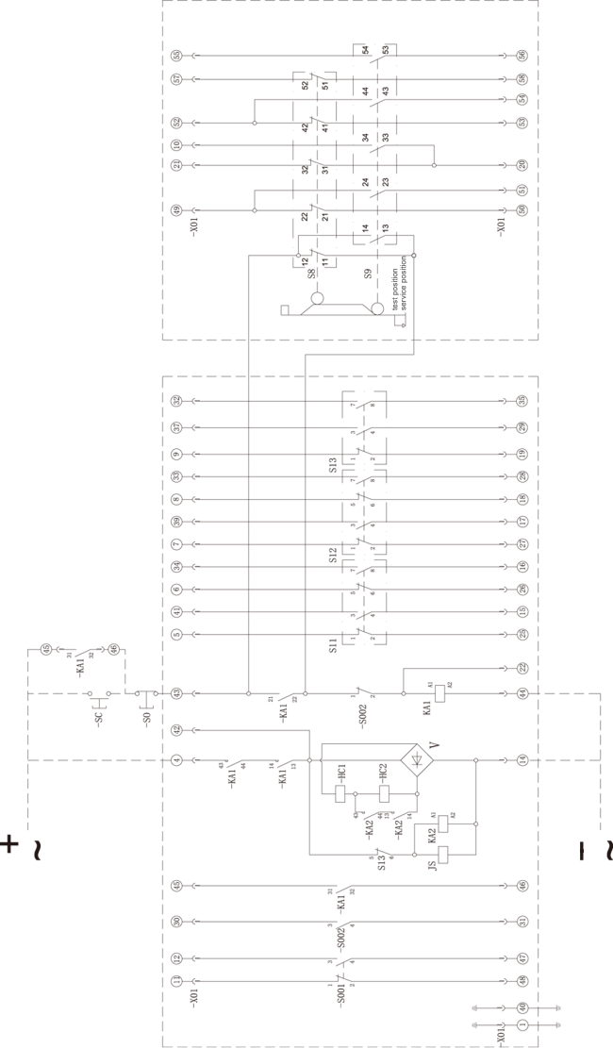
Electrical Control Wiring
Electrical wiring diagram for withdrawable type VEC vacuum contactor & fuse combination unit（electrical holding）
▍
Note: this figure corresponds to the state that the contactor is in the opening position, the handcart is in the experimental position and the fuse has not blown.
• S11-13 Contactor position microswitch
• S001-S002 Fuse indicator microswitch
• S8 Experimental position limit switch
• S9 Working position limit switch
• X01 58 core aviation plug
• HC1，HC2 Closing electromagnet
• SC Closing button
• SO Opening button
• KA1，KA2 Intermediate relay
• JS Counter
• V Rectifier bridge
12 | VEC Catalog
www.leistung-energie.com

Slide 12
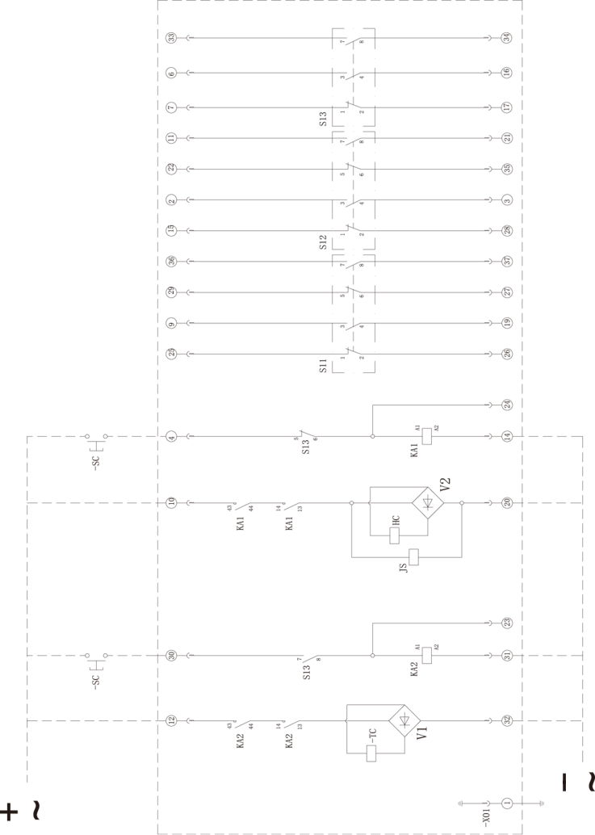
Electrical Control Wiring
Electrical wiring diagram for fixed-type VEC vacuum contactor & fuse combination unit（mechanical holding）
▍
Note: this figure corresponds to the state that the contactor is in the opening position.
• S11-13 Contactor position microswitch
• X01 58 core aviation plug
• HC Closing electromagnet
• TC Opening electromagnet
• SC Closing button
• SO Opening button
• KA1，KA2 Intermediate relay
• JS Counter
• V1，V2 Rectifier bridge
www.leistung-energie.com
VEC Catalog | 13

Slide 13
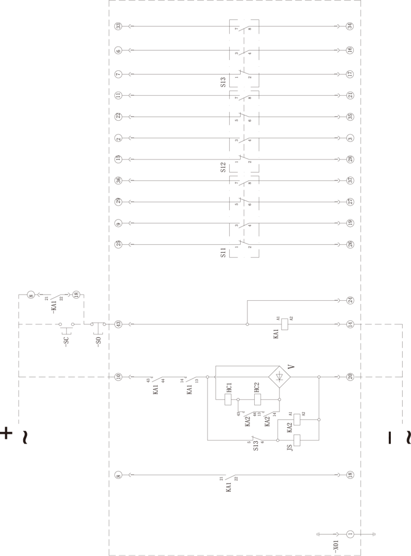
Electrical Control Wiring
Electrical wiring diagram for fixed-type VEC vacuum contactor & fuse combination unit（electrical holding)
▍
Note: this figure corresponds to the state that the contactor is in the opening position.
• S11-13 Contactor position microswitch
• X01 58 core aviation plug
• HC1，HC2 Closing electromagnet
• SC Closing button
• SO Opening button
• KA1，KA2 Intermediate relay
• JS Counter
• V Rectifier bridge
14 | VEC Catalog
www.leistung-energie.com

Slide 14
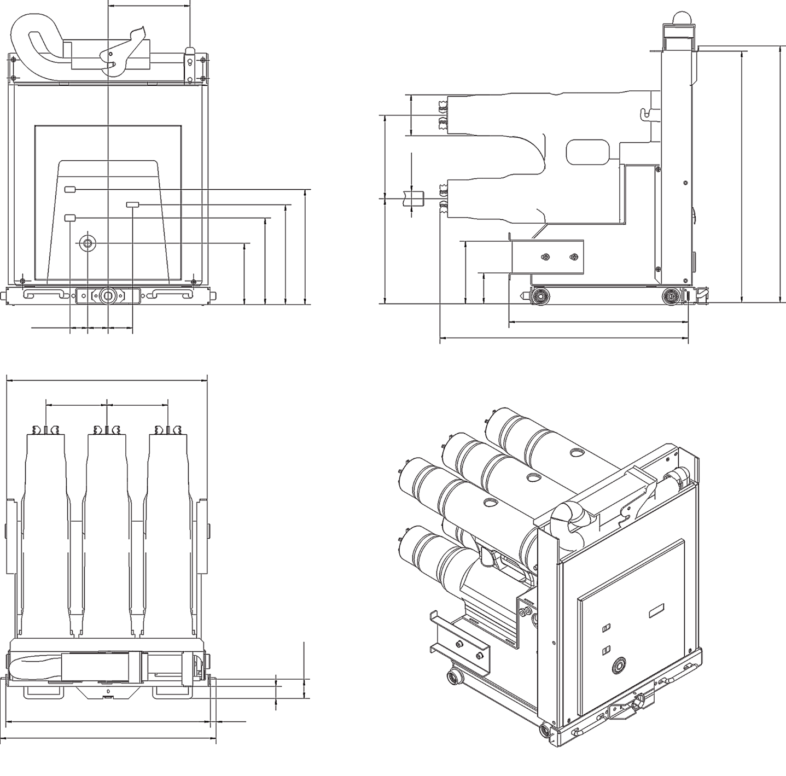
Outline Dimension Drawing
Outline dimension drawing for withdrawable type VEC vacuum contactor & fuse combination unit
201
Φ100.5
205±1.5
φ35
618
630
Fuse indicator
Counter
Closing/Opening indicator
282.5
260±1.5
Opening button
245.5
212.5
154
150.5
76
43.5
50
60
609
438
150±1
492
150±1
(51)
502
14
(33)
530
www.leistung-energie.com
VEC Catalog | 15

Slide 15
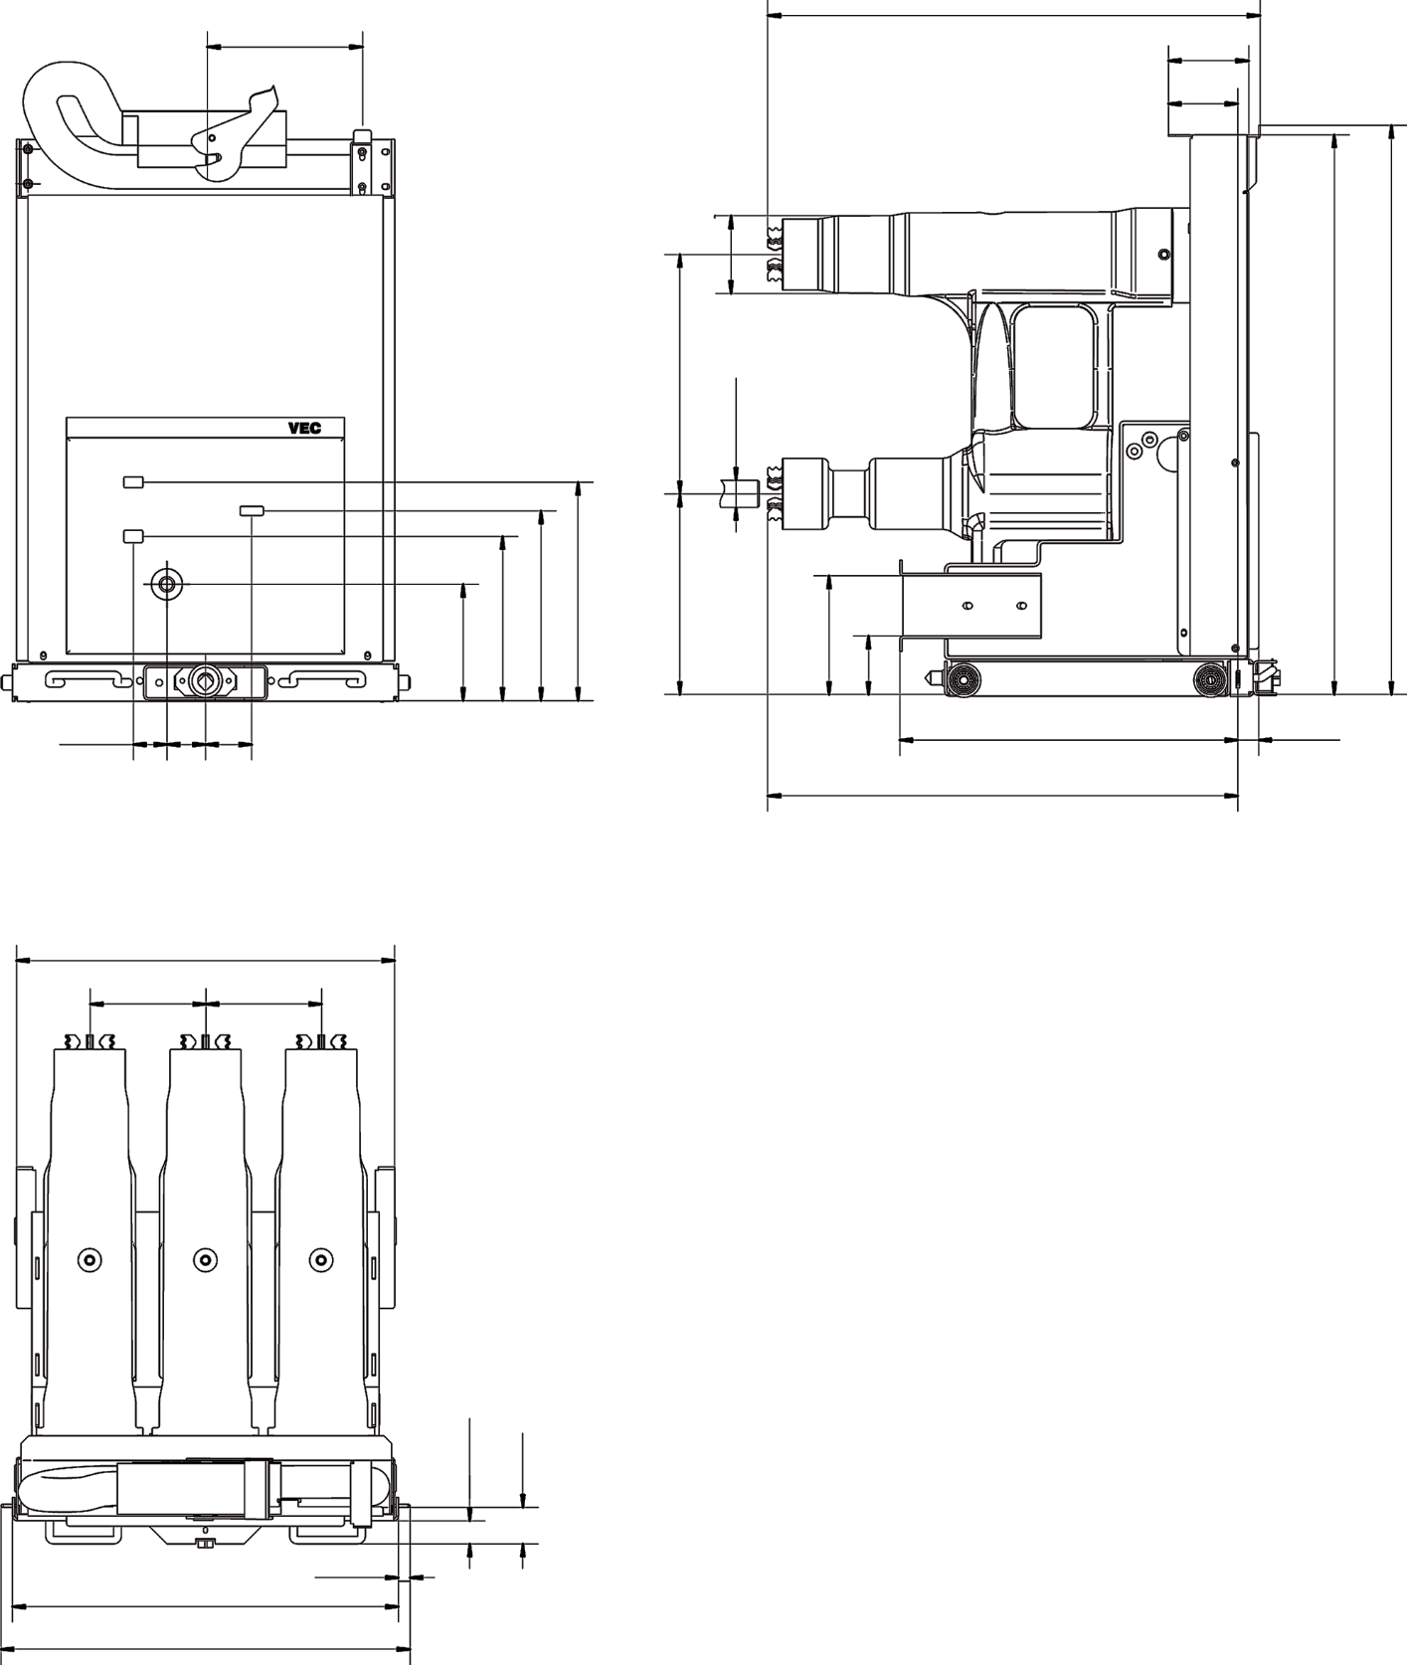
Outline Dimension Drawing
Outline dimension drawing for withdrawable type VEC vacuum contactor & fuse combination unit (310mm version)
201
638
104
90
Φ100.5
310±1
726
737
φ35
Fuse indication
Counter
Closing/opening
282.5
260
Trip
245.5
212.5
154
150.5
76
43.5
50
60
438
609
490
150±1
150±1
(33)
(51)
502
14
530
16 | VEC Catalog
www.leistung-energie.com

Slide 16
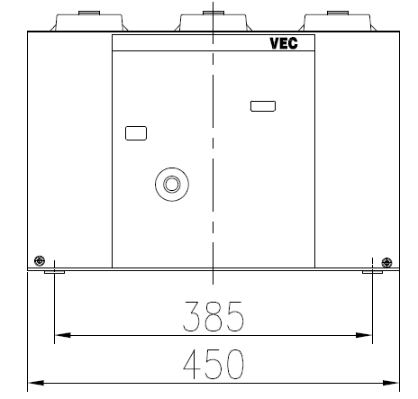
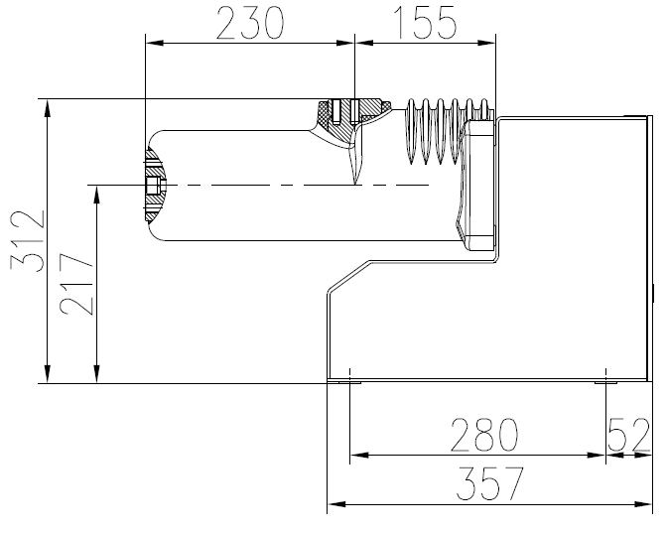
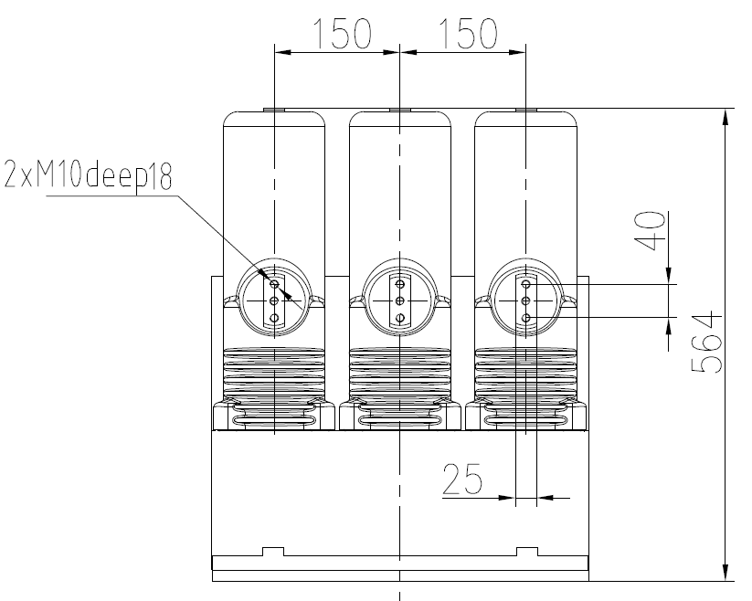
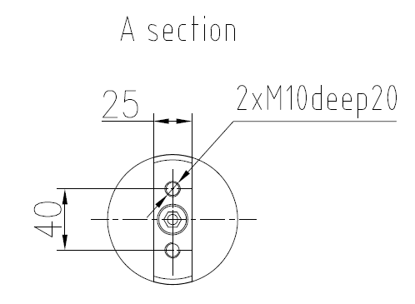
Outline Dimension Drawing
Outline dimension drawing for fixed-type vacuum contactor
Closing/Opening
Indicator
Counter
A section
Opening button
www.leistung-energie.com
VEC Catalog | 17

Slide 17
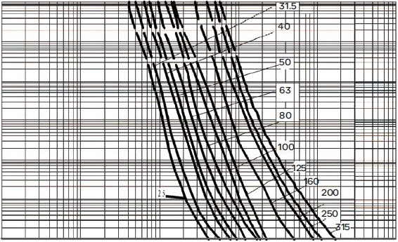
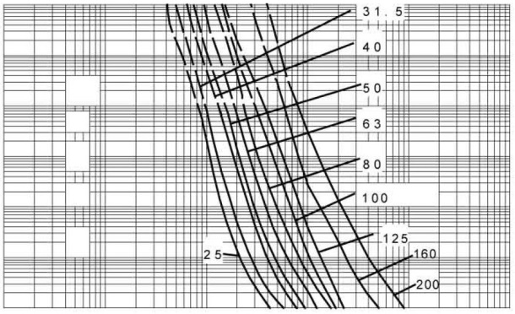
Fuse Selection Guide (for reference only)
The vacuum contactor-fuse combination appliance is operated by a fuse to realize the switching off of short-circuit current, while the vacuum contactor bears the closing and breaking of overload current and normal working current. In order to realize short-circuit protection reliably, it is very important to match the contactor with a suitable current limiting fuse. The selection of fuses should be in accordance with the applicable guidelines in Appendix C to the GB15166.2, or meet the DIN criteria. Users may also refer to the following selection principles.
Fuse selection for motor protection
Following factors need to be considered: working voltage, working current, starting time, starting times per hour, full load current of motor, short circuit current at installation site, application scope of fuse etc. with details as follows:
The rated voltage of fuse shall be not less than the working voltage of the system.
The rated current of fuse shall be selected according to the following formula and chart
ly=Nlnδ
where：In—full load current of motor
δ—Comprehensive coefficient
N—Ratio of starting current to full load current, usually N=6
ly—Current value during starting time
Draw the point of ly value corresponding to the starting time on the fuse time current characteristic curve provided by the fuse manufacturer. The fuse with curve corresponding to the point or the curve close to the right of this point is the optional one. And the rated current of the fuse should be greater than 1.7 times of full load current of motor (20% capacity reduction in closed environment has been considered).
Starting times / hour | 2 | 4 | 8 | 16
δ | 1.7 | 1.9 | 2.1 | 2.3
For example: 12kV system, 1125kw motor, power factor is 0.85, efficiency is 0.9, starting frequency ≤ 2 times / h, starting time ≤ 6S, motor full load current In = 84.9A, then ly = 866A. For 12kV system, the fuse specification is 160A with point found on fuse time-current characteristic curve, corresponding to 866A, 6S. It is verified that 160 > 1.7 * 84.9, so the fuse can be selected with specifications above 160A.
10,000
1000
100
10
1
0.1
0.01
10,000
1000
100
10
1
0.1
0.01
Pre arcing time (S)
Pre arcing time (S)
10 100 1000 10,000 100,000
10 100 1000 10,000 100,000
▍Prospective current effective value(A)
WDL、WFL、WKL-7.2Time-current characteristic
Table：Xirong WDL、WFL、WKL-7.2 Time-current characteristic curve
▍Prospective current effective value(A)
WDL、WFL、WKL-7.2Time-current characteristic
Table：Xirong WDL、WFL、WKL-12Time-current characteristic curve
18 | VEC Catalog
www.leistung-energie.com

Slide 18
Fuse Selection Guide (for reference only)
v
Fuse selection for transformer protection
The selection of fuse for transformer protection shall be coordinated with the protection device of contactor and be able to withstand high inrush current of transformer. The selection principle of rated current is shown in the following table:
▍
Transformer protection fuse selection table
Transformer capacity (kVA) | Transformer primary voltage 7.2kV | Transformer primary voltage 12kV
 | Fuse rated current (A) | Fuse rated current (A)
50
100 | 20 | 16
125 | 20 | 16
160 | 25 | 16
200 | 31.5 | 20
250 | 40 | 25
300/315 | 50 | 31.5
400 | 71 | 40
500 | 80 | 50
630 | 100 | 63
800 | 140 | 80
1000 | 160 | 100
1250 | 200 | 125
1600 | 250 | 160
www.leistung-energie.com
VEC Catalog | 19

Slide 19
Notes
20 | VEC Catalog
www.leistung-energie.com

Slide 20
Leistung Energie/Catalog/VEC/202204/EN
Distributed by

